Slide 1
Test Application
By
Chinmay Naik
112003093
Ajinkya Narkhede
112003095

Slide 2

Description
A basic Test Application to solve and generate tests.
It offers you an user friendly interface to meet your purpose.
Very easy to open an account.
Easy to manage the tests for the admin by generating access codes for the tests and then giving them to selected users only as per his/her wish.
Timer available for the user during the test to manage the time.

Slide 3



Software Used
The whole application is made using python using different modules like:-
Kivy:- A python library for app development.
Pandas:-For Data Manipulation
Json:-For storing the data on the cloud

Slide 4
What is Kivy?
Kivy is a open source Python library for rapid development of applications that make use of innovative user interfaces, such as multi-touch apps.
Kivy helps us to design innovative user interfaces with multi-touch functionalities.
It helps us to run code on all supported platforms.
It provides well-documented APIs.
It offers a better representation of programs, including classes, widget configuration, and inherited classes.
It performs better than HTML 5.

Slide 5
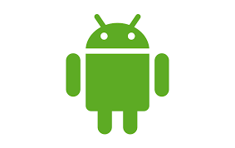


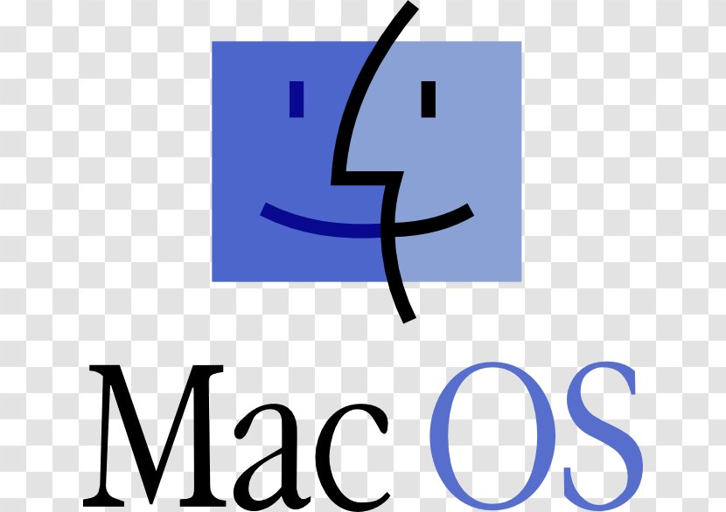

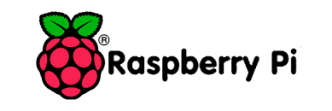
Kivy Application Runs on

Slide 6
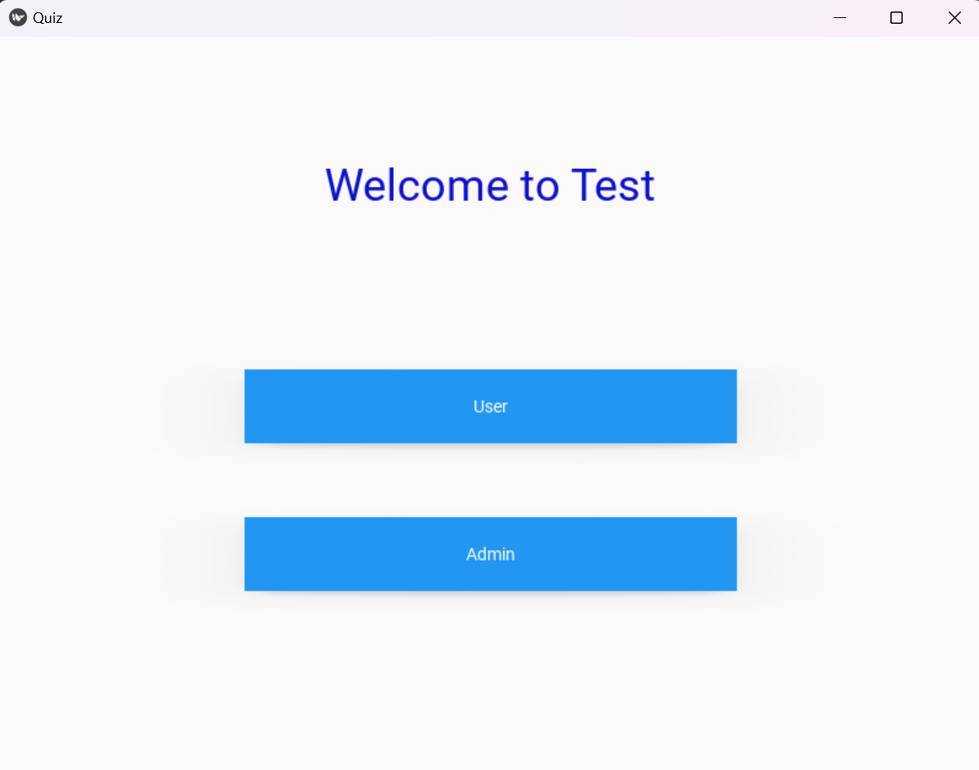
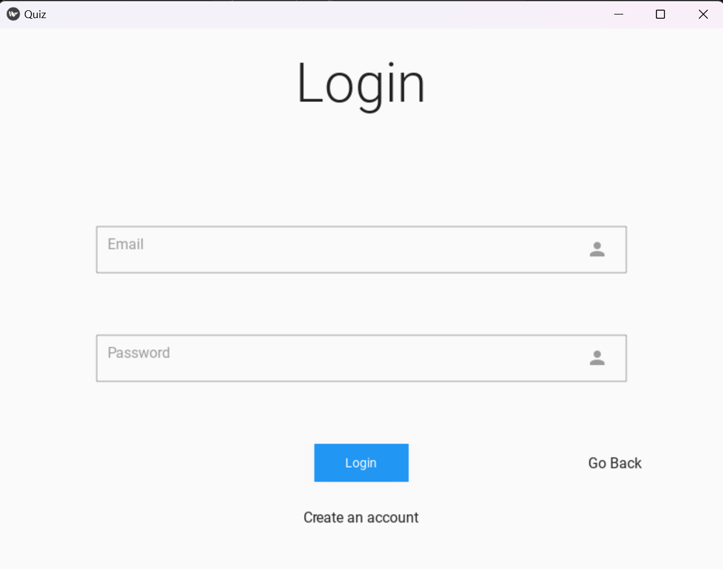
Screenshots

Slide 7
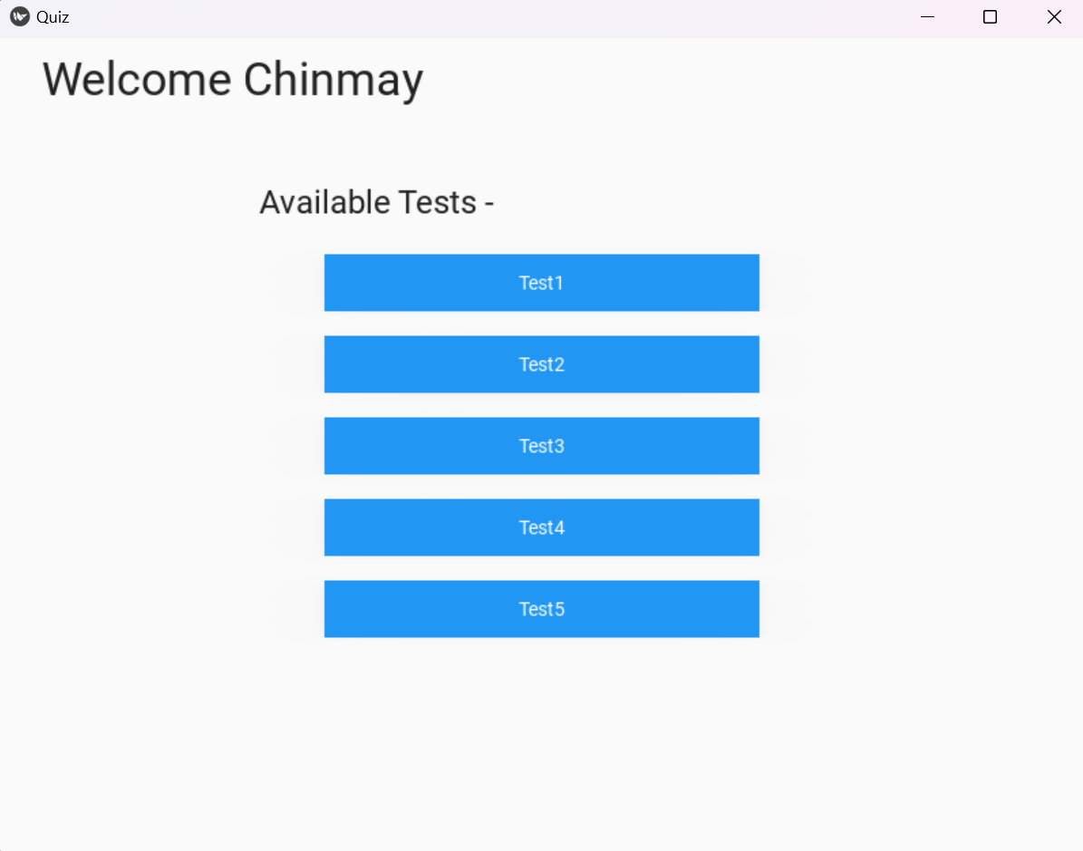
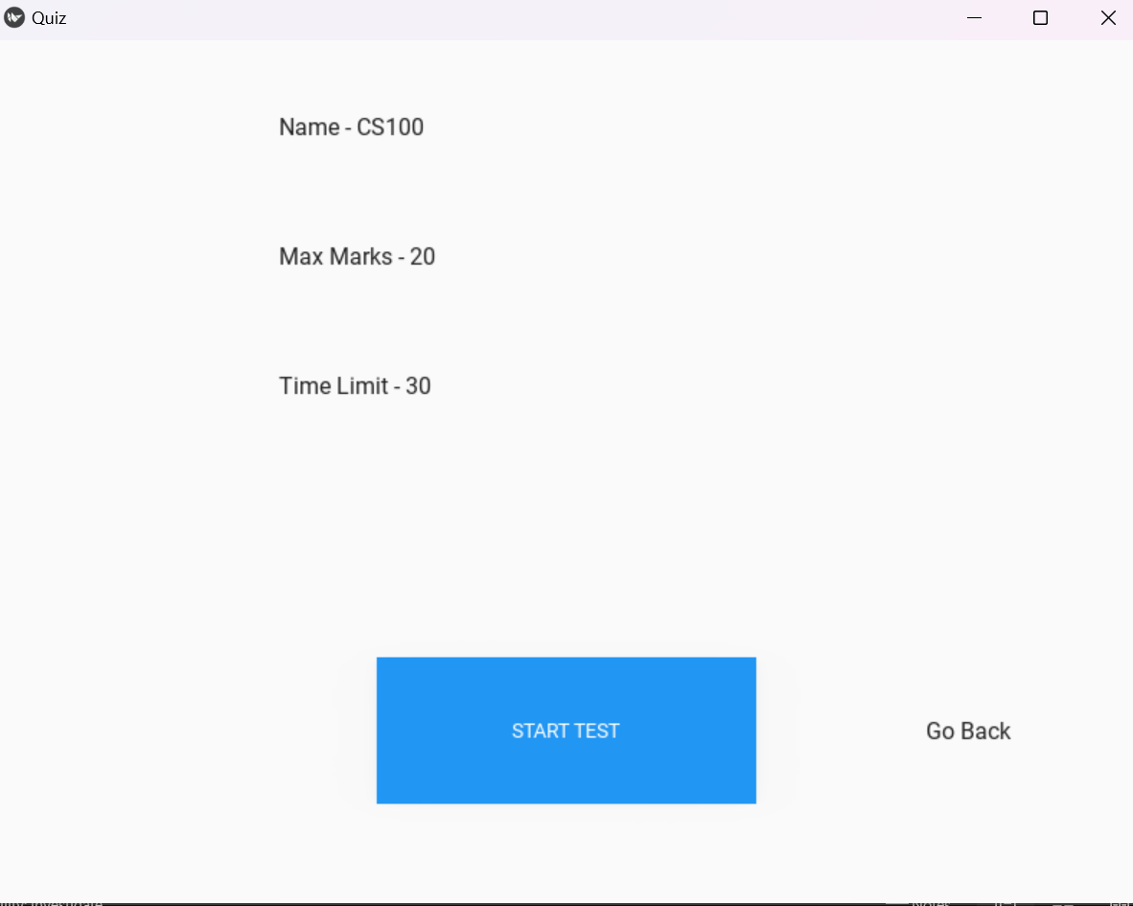

Slide 8
